Slide 1
Message-Oriented Middleware

Slide 2
Message Oriented Middleware
Message Oriented Middleware (or “MOM”) is one particular form of middleware, which is capable of facilitating the transportation of asynchronous messages from one component to another.
High-level message queuing model
Communication does not follow the rather strict pattern of client/server interaction.

Slide 3
Message-Oriented Middleware (MOM)
Communication using messages
Messages stored in message queues
Message servers decouple client and server
Client App.
Message Servers
Server App.
local message
queues
message
queues
local message
queues
Network
Network
Network
Notes:
3

Slide 4
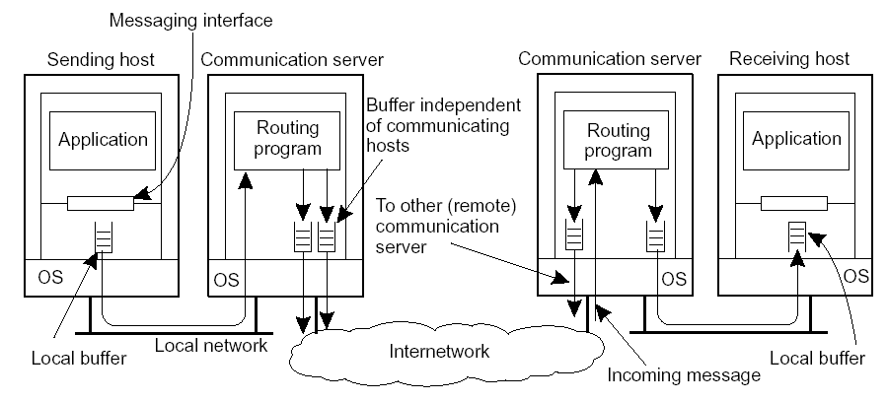
Asynchronous Communication: Messaging
Message-oriented middleware: Aims at high-level asynchronous communication:
Processes send each other messages, which are queued
Sender need not wait for immediate reply, but can do other things
Middleware often ensures fault tolerance

Slide 5
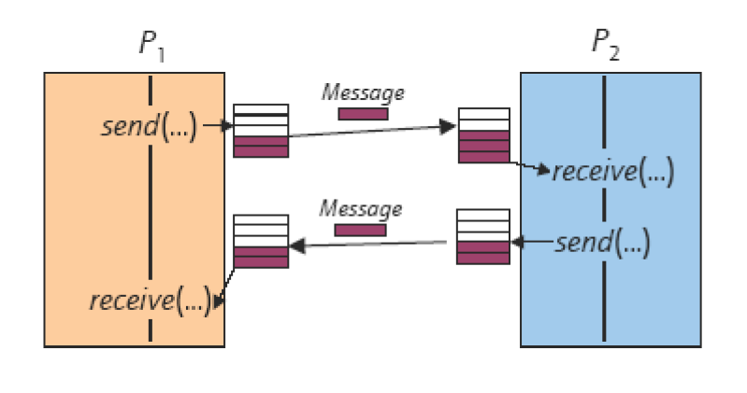
Asynchronous Communication

Slide 6
Asynchronous Communication
Discussion
What are the advantages of asynchronous communication?
What are the disadvantages of asynchronous communication?
Please go to
PollEv.com/cisgvsu429
Notes:
6

Slide 7
Asynchronous Communication
Loosely coupled
Pros:
Higher degree of parallelism
May compensate speed deviation between sender and receiver
Sender and receiver do not have to run on the same time
Cons:
Complicates synchronization
Sender has no information about message delivery
Possible buffer overflows
Notes:
7

Slide 8
Message-Oriented Communication
Message Queuing Systems or Message-Oriented Middleware (MOM)
Offer intermediate-term storage capacity for messages
No need for either the sender or receiver to be active during message transmission
Support message transfers that are allowed to take minutes.
Notes:
8

Slide 9
Properties of MOM
Asynchronous interaction
Client and server are only loosely coupled
Messages are queued
Good for application integration
No need for either the sender or receiver to be active during message transmission
Support message transfers that are allowed to take minutes.
Processing of messages by intermediate message server(s)
May do filtering, scheduling, …
Networks of message servers
Offer intermediate-term storage capacity for messages
Notes:
9

Slide 10
Message-Queuing Model
Basic idea: applications communicate by inserting messages in specific queues
Messages forwarded over a series of communication servers before being finally being delivered to the destination
Receiver can be down when message was sent
No need for the sender to be executing when a message is picked up by the receiver
Usually, sender is offered the guarantee that its message will eventually be inserted into the recipient’s queue, but no guarantee about when
Notes:
10
Basic idea: applications communicate by inserting messages in specific queues
These messages could be forwarded over a series of communication servers before being finally delivered to the destination, even if the destination was down when the message was sent
The sender is offered the guarantee that its message will eventually be inserted into the recipient’s queue, but no guarantee about when.
No need for the receiver to be executing when a message is being sent to its queue.
Likewise, no need for the sender to be executing when a message is picked up by the receiver

Slide 11
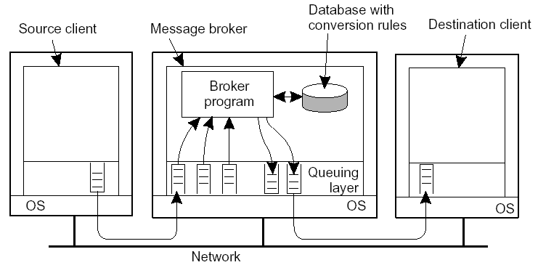
Message Broker
Observation: Message queuing systems assume a common messaging protocol: all applications agree on message format (i.e., structure and data representation)
Message broker: Centralized component that takes care of application heterogeneity in a message-queuing system:
Transforms incoming messages to target format, possibly using intermediate representation

Slide 12
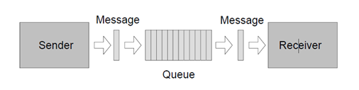
Queues
serve as an intermediary between sender and receiver
Sender puts messages into queues
Message is transmitted to receiver
Receiver reads message from queues
Allow processes to execute and fail independently
Can mask process failures and communication failures
Usually FIFO
Notes:
12

Slide 13
Discussion
What could be the problems/disadvantages for the FIFO approach to process messages in a queue?
Can you propose some other solutions other than FIFO to process messages in a queue?
Please go to
PollEv.com/cisgvsu429
Notes:
13

Slide 14
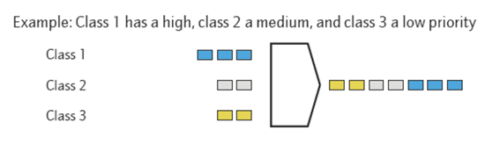
Message Priorities – Highest Priority First
What could be the problems/disadvantages for the Highest Priority First approach to process messages in a queue?
Please go to
PollEv.com/cisgvsu429
Notes:
14

Slide 15
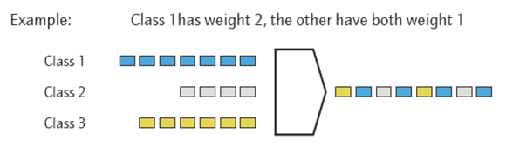
Message Priorities – Weighted Fair Scheduling
Notes:
15

Slide 16
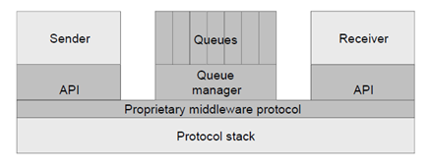
Queue Manager
Provides means for administration
Creation/deletion of queues
Allows to start and to stop queues
Alter properties of existing queues
Allows monitoring of performance, failures, and recoveries
Often queue managers can be configured to forward messages to other queue managers
Notes:
16

Slide 17
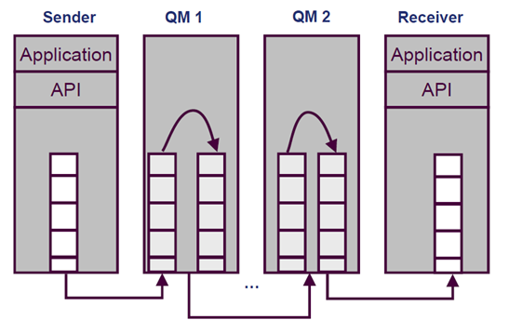
MOM – Message Oriented Middleware
Notes:
17

Slide 18
Queuing Messaging Pattern
One-to-One
One sender, one receiver
Point-to-Point
One-to-Many
One sender, many receivers
Many-to-One
Many senders, one receiver
Many-to-Many
Many senders, many receivers
-> Publish and Subscribe
Notes:
18

Slide 19
Publish/Subscribe Model
One important and common use of a Message Broker is to help form the Publish/Subscribe model (paradigm)
In such a model, a broker is responsible not only for converting messages but also for matching applications based on the messages that are being exchanged
Applications may publish a message on topic X by sending it to the broker
Applications with interest in messages on topic X can subscribe to these messages, and will then receive them from the broker

Slide 20
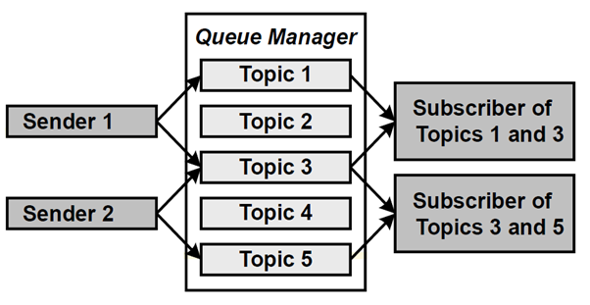
Publish and Subscribe
Notes:
20

Slide 21
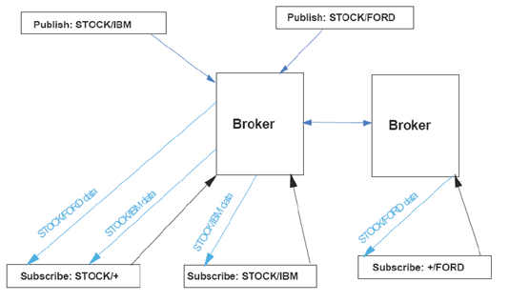
Publish and Subscribe Example
Notes:
21

